Slide 1


Corona vs. Malaria
Presentation by Norman, Panarat, and Sarah

Slide 2
Project Set-up
Research led to various resources of interest.
Promising topics put into GitHub
Team formed/informed
Team selected 2 data sources
Data sources are Malaria and COVID-19

Slide 3

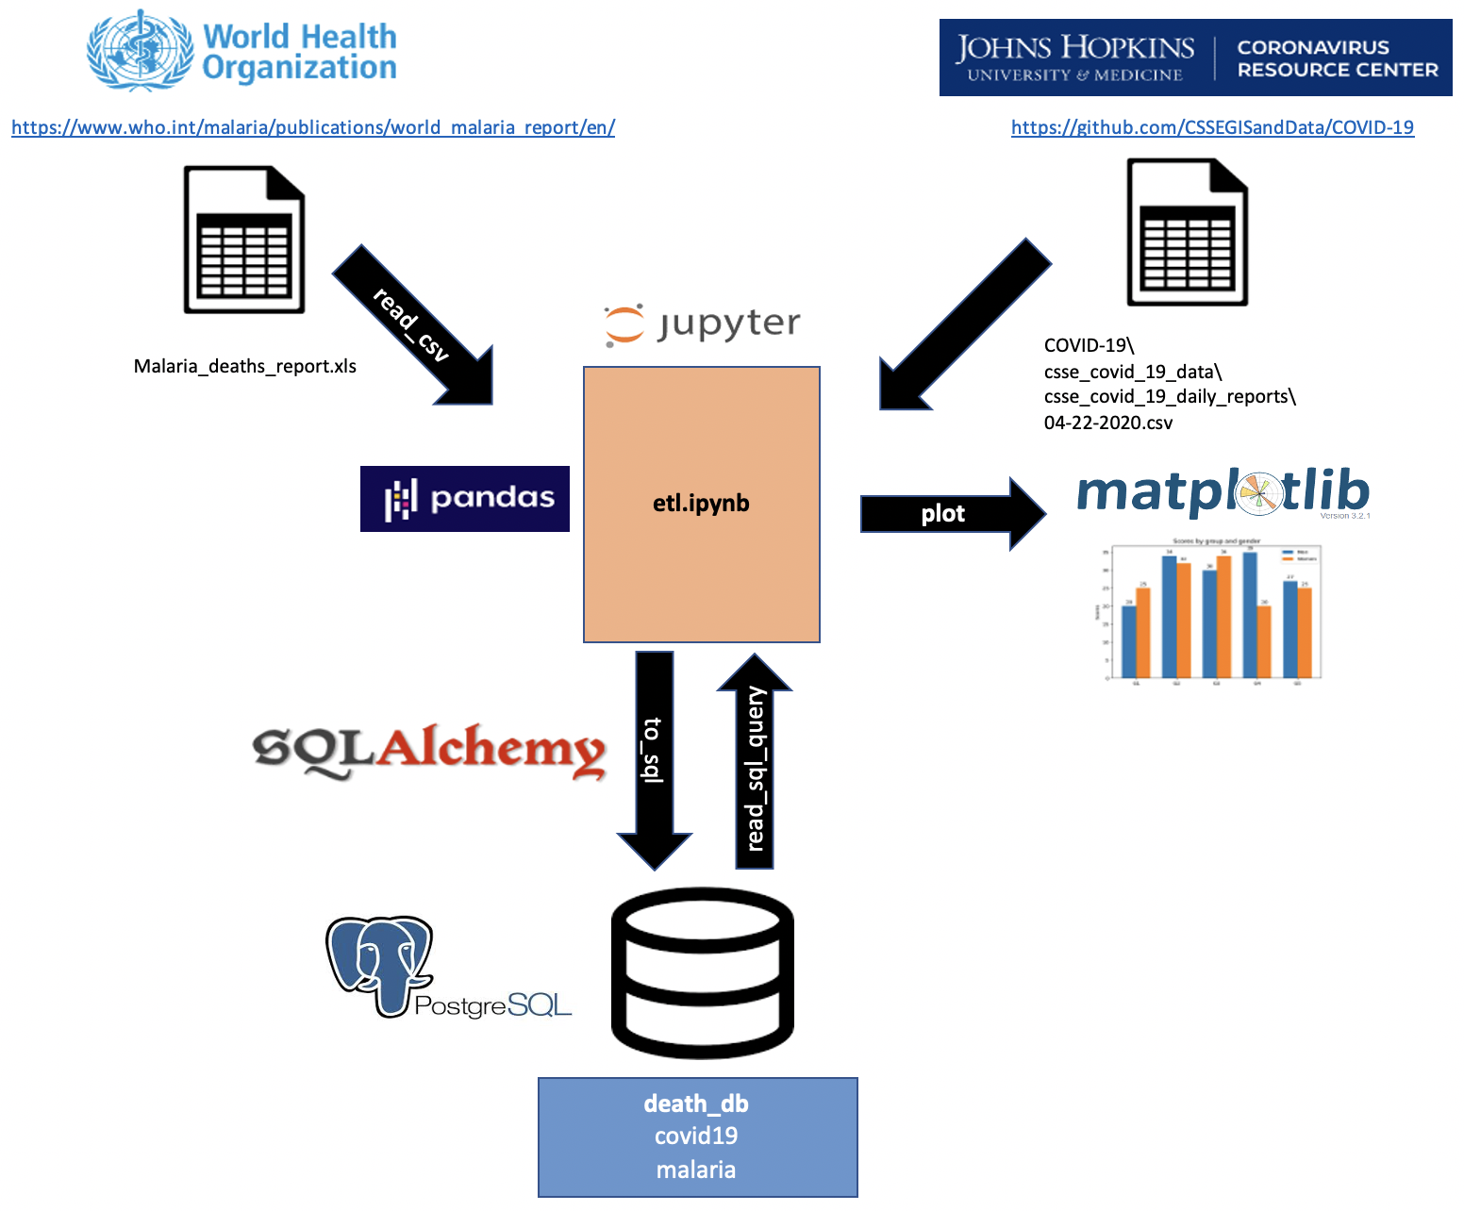
Data Flow
WHO provided Malaria data
John Hopkins provided COVID data
Performed Extraction/Transform/Load: Jupyter Notebook
Utilized PostgreSQL relational database to persist, analyze, and join 2 data sets.
Analysis could be performed with Matplotlib in Jupyter Notebook.

Slide 4
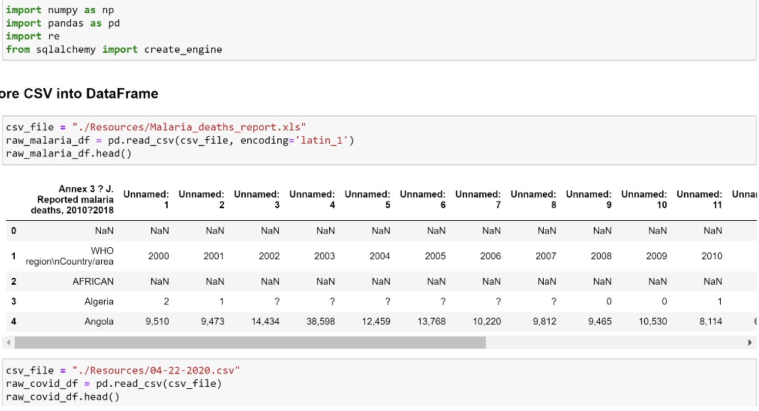
Data Retrieval
Both data sources were CSV files.
Malaria file required latin_1 encoding.
Latest COVID file was from 4/22/2020

Slide 5
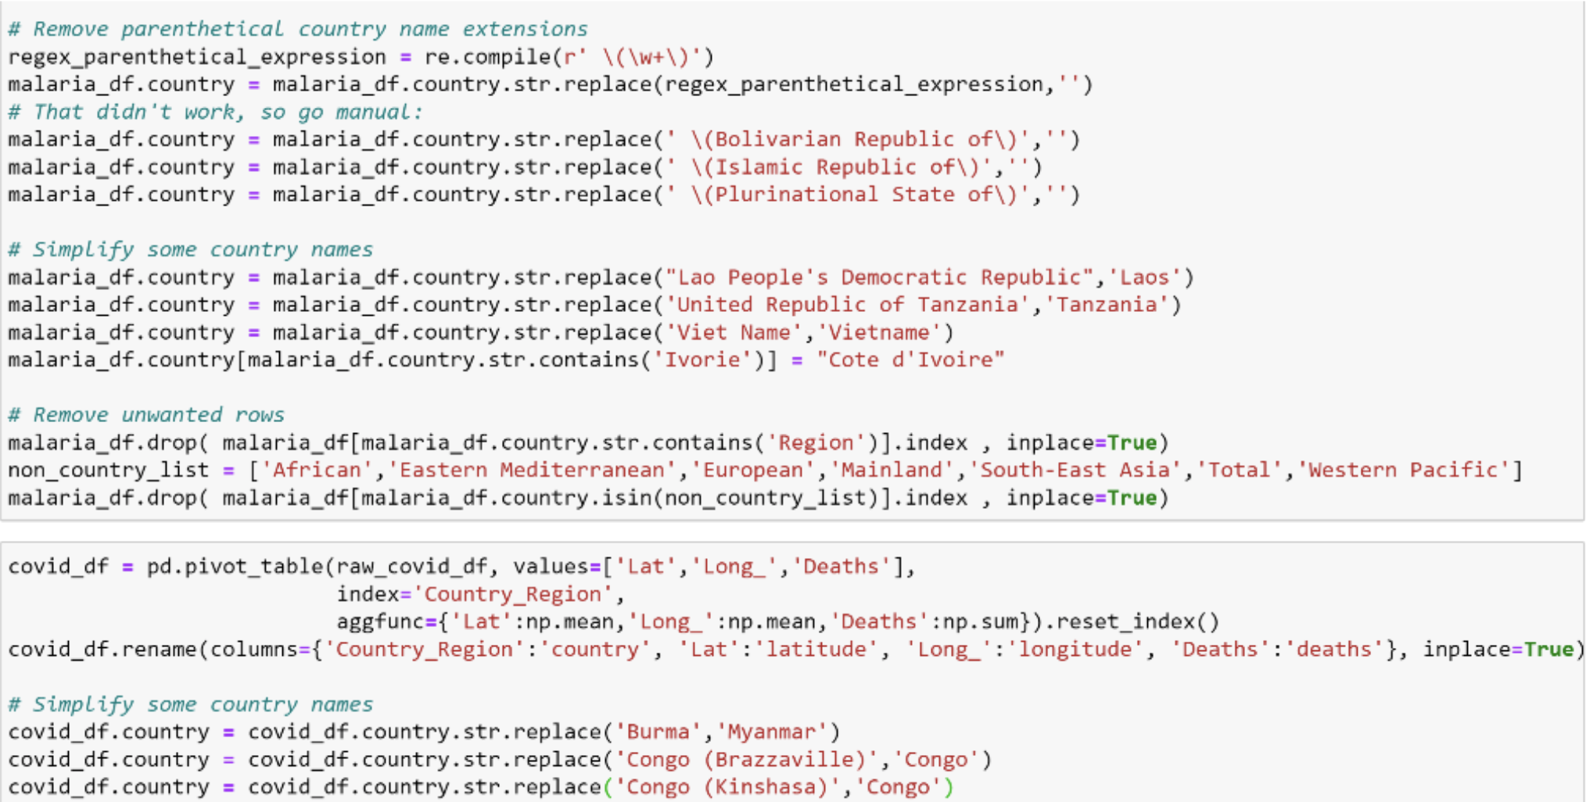
Data Cleanup
Selected pertinent columns
Filtered impertinent rows
Manipulated country names for commonality
Renamed columns
Went with lowercase for ease of use with PostgreSQL
Simple and common.

Slide 6
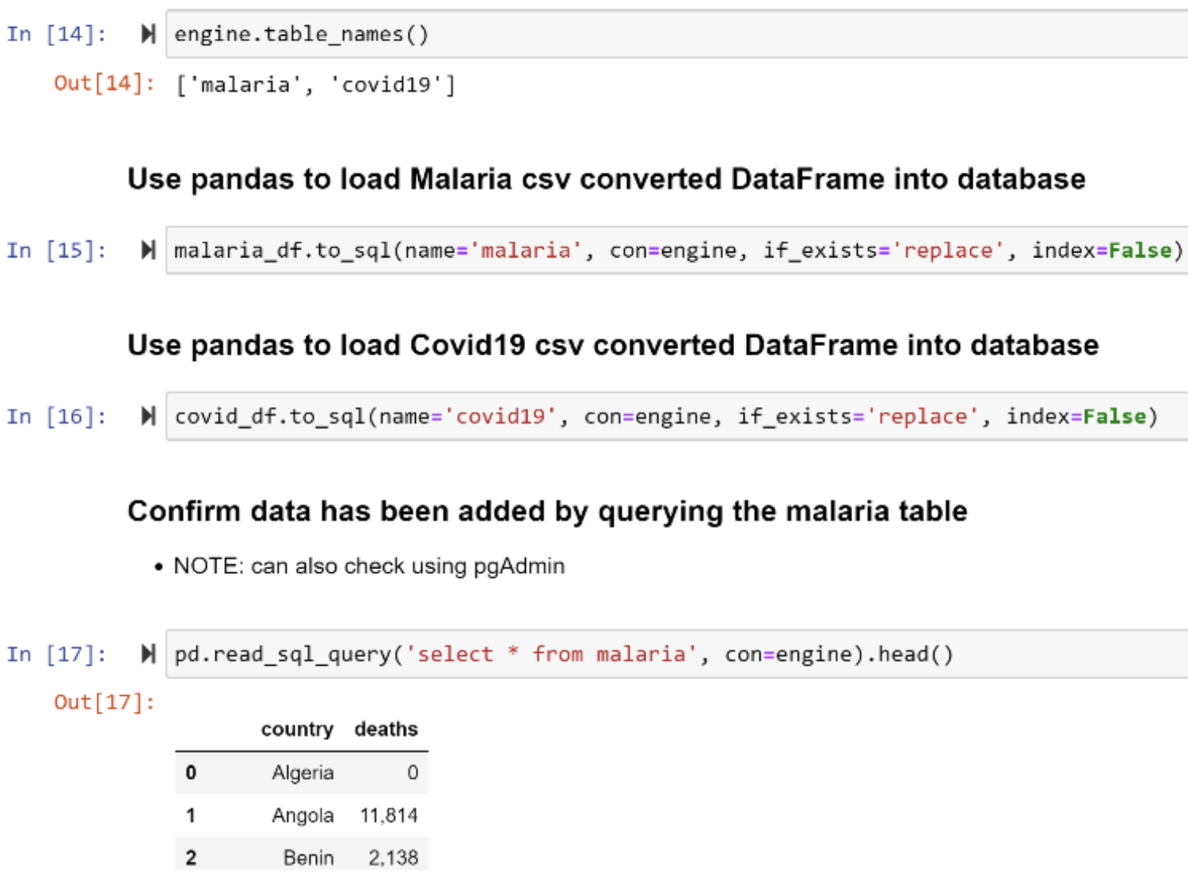
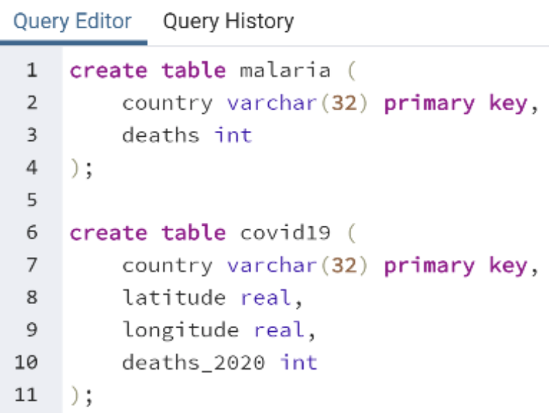
Data oad
Create tables in PostgreSQL
Used Pandas to load data into PostgreSQL.
Used SQL to check for identical country names.

Slide 7
Potential Analysis
Matplotlib in Jupyter Notebook could have been used for visualization.
The SQL tables provide persistent records for further studies in SQL or external tools.
Potential studies
Demographic causes
Geographic causes
Economic causes

Slide 8
References
CSSEGISandData. (2020, April 24). CSSEGISandData/COVID-19. Retrieved April 25, 2020, from https://github.com/CSSEGISandData/COVID-19
World malaria report. (2019, December 4). Retrieved April 25, 2020, from https://www.who.int/malaria/publications/world_malaria_report/en/

Slide 9
Thank you!!

